Slide 1

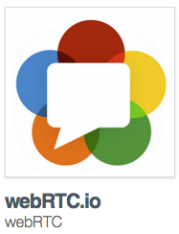
Parameswari Ettiappan

Slide 2
What’s WebRTC?
“ WebRTC is a new front in the long war for an open and unencumbered web. — Brendan Eich, inventor of JavaScript

Slide 3
What’s WebRTC?
Web Real-Time Communication (WebRTC) is an upcoming standard that aims to enable real-time communication among Web browsers in a peer-to-peer fashion.
WebRTC project (opensource) aims to allow browsers to natively support interactive peer to peer communications and real time data collaboration.
Provide state of art audio/video communication stack in your browser.

Slide 4
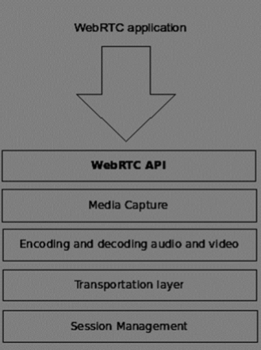
What’s WebRTC?
https://apprtc.appspot.com/

Slide 5
Earlier Efforts
Many web services already use RTC, but need downloads, native apps or plugins. These includes Skype, Facebook (uses Skype) and Google Hangouts (uses Google Talk plugin).
Downloading, installing and updating plugins can be complex, error prone and annoying.
Plugins can be difficult to deploy, debug, troubleshoot, test and maintain—and may require licensing and integration with complex, expensive technology.
Integrating RTC technology with existing content, data and services has been difficult and time consuming, particularly on the web.

Slide 6
What does it change?
No licenses or other fees.
Integration via simple, standardized Web APIs.
No Proprietary plugins.
No Security issues.
No downloads, no installation.
Just surf to the right address!

Slide 7
Aims of WebRTC
State of art audio/video communication stack in your browser.
Seamless person-to-person communication.
Specification to achieve inter-operability among Web browsers.
Interoperability with legacy systems.
Low cost and highly efficient communication solution to enterprises.

Slide 8
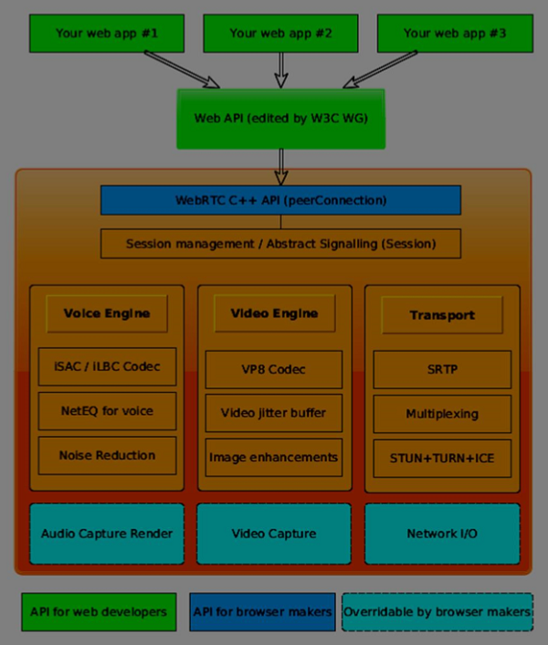

Slide 9
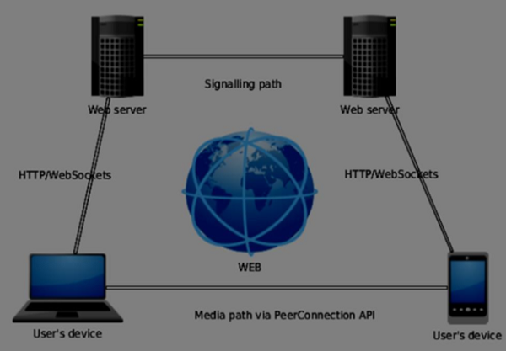
SIP(Session Initiation Protocol) Trapezoid

Slide 10
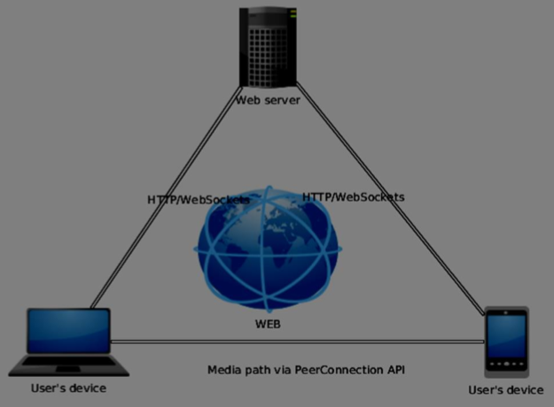
Triangle

Slide 11
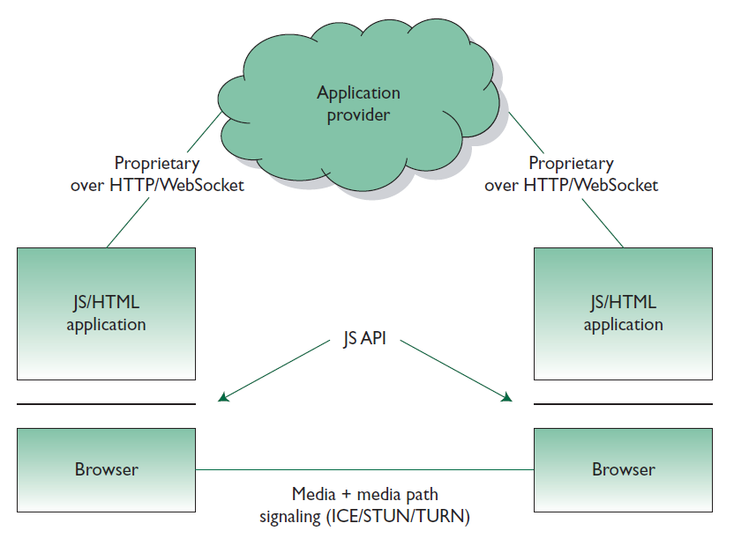
Architecture

Slide 12
Architecture
At startup, browsers do not know each other.
JavaScript mediates the setup process through server.
Media flows through the shortest possible path for latency.

Slide 13
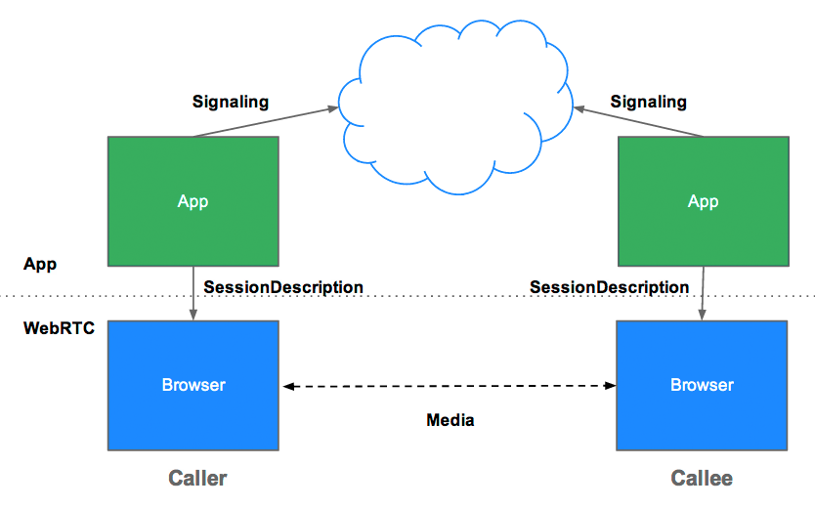
How peers connect?

Slide 14
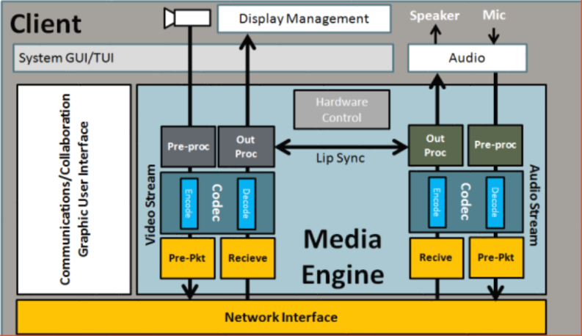
WebRTC Media Engine

Slide 15
WebRTC App. Need TO
Get streaming audio, video or other data.
Get network information such as IP address and port, and exchange this with other WebRTC clients (known as peers).
Coordinate signaling communication to report errors and initiate or close sessions.
Exchange information about media and client capability, such as resolution and codecs.
Communicate streaming audio, video or data.

Slide 16
Signaling
Mechanism to coordinate communication and to send control messages.
Signaling methods and protocols are not specified by WebRTC but by application developer.
Signaling is used to exchange three types of information :
Session control messages : to initialize or close communication and report errors.
Network configuration : what's my computer's IP address and port?
Media capabilities : what codecs and resolutions can be handled by my browser and the browser it wants to communicate with?

Slide 17
Signaling
The original idea to exchange Session Description information was in the form of Session Description Protocol (SDP) “blobs”.
This approach had several shortcomings some of which would be difficult to address.
IETF is standardizing the JavaScript Session Establishment Protocol (JSEP).
JSEP provides the interface an application needs to deal with the negotiated local and remote session descriptions.
The JSEP approach leaves the responsibility for driving the signaling state machine entirely to the application.

Slide 18
WebRTC API
getUserMedia (MediaStream)
RTCPeerConnection
RTCDataChannel

Slide 19



WebRTC API Stack View
getUserMedia API
getUserMedia API
DTLS
WebRTC APP
WebRTC APP
SRTP/SCTP
PeerConnection API
ICE
PeerConnection API
DataChannel API
UDP
DataChannel API

Slide 20
getUserMedia
A MediaStream is an abstract representation of an actual data stream of audio or video.
Serves as a handle for managing actions on the media stream.
A MediaStream can be extended to represent a stream that either comes from (remote stream) or is sent to (local stream) a remote node.
A LocalMediaStream represents a media stream from a local media-capture device (such as a webcam or microphone).

Slide 21
getUserMedia
The MediaStream represents synchronized streams of media. For example, a stream taken from camera and microphone input has synchronized video and audio tracks.
The getUserMedia() method takes three parameters:
A constraints object.
A success callback which, if called, is passed a LocalMediaStream.
A failure callback which, if called, is passed an error object.
In Chrome, the URL.createObjectURL () method converts a LocalMediaStream to a Blob URL which can be set as the src of a video element.

Slide 22
getUserMedia
<video id="sourcevid" autoplay></video>
<script>
var video = document.getElementById('sourcevid');
navigator.getUserMedia('video', success, error);
function success(stream) {
video.src = window.URL.createObjectURL(stream);
}
</script>

Slide 23
RTCPeerConnection
RTCPeerConnection is the WebRTC API that handles stable and efficient communication of streaming data between peers.
Communications are coordinated via a signaling channel provided by scripting code in the page via the Web server — for instance, using XMLHttpRequest or WebSocket.

Slide 24
RTCPeerConnection
In the real world, WebRTC needs servers, so the following can happen:
Users discover each other and exchange 'real world' details such as names.
WebRTC client applications (peers) exchange network information.
Peers exchange data about media such as video format and resolution.
WebRTC client applications traverse NAT gateways and firewalls.

Slide 25
NAT,STUN and TURN
A Public IP Address is an IP address that is globally unique across the Internet. Only one device may be in possession of a public IP address.
A Private IP Address is an IP address that is not globally unique and may exist simultaneously on many different devices. A private IP address is never directly connected to the Internet. Devices that possesses a private IP address will be in their own unique IP space (e.g. different companies or domains). The chances are extremely high that the device you are using to read this blog article has acquired a private IP address.

Slide 26
NAT,STUN and TURN
Network Address Translation (NAT) gives private IP addresses access to the Internet. NAT allows a single devices, such as a router, to act as an agent between the Internet (populated with public IP addresses) and a private network (populated with private IP addresses). A NAT device can use a single public IP address to represent many private IP addresses.
A Symmetric NAT not only translates the IP address from private to public (and vice versa), it also translates ports. There are various rules as to how that translation and mapping occurs, but it’s safe to say that with symmetric NAT.

Slide 27
Deploying STUN and TURN
Google runs a public STUN server, stun.l.google.com:19302, as used by apprtc.appspot.com.
For a production STUN/TURN service, recommended to use the rfc5766-turn-server; source code for STUN and TURN servers is available from code.google.com/p/rfc5766-turn-server, which also provides links to several sources of information about server installation.
A VM image for Amazon Web Services is also available.

Slide 28
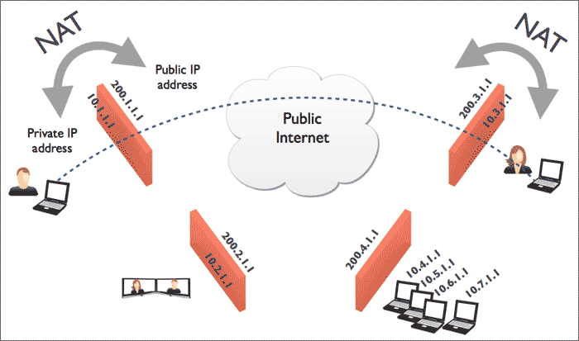

Slide 29
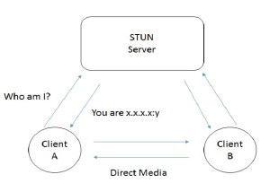

Slide 30
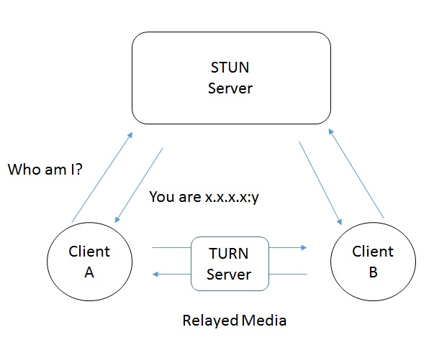

Slide 31
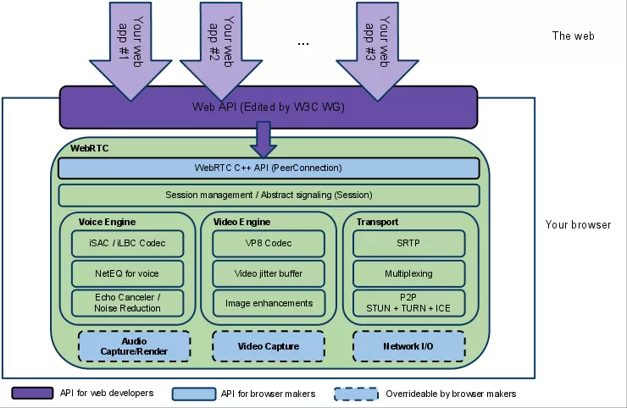
RTCPeerConnection

Slide 32
NAT Traversal
Suffice to say that the STUN protocol and its extension TURN are used by the ICE framework to enable RTCPeerConnection to cope with NAT traversal.
Initially, ICE tries to connect peers directly, with the lowest possible latency, via UDP. In this process, STUN servers have a single task: to enable a peer behind a NAT to find out its public address and port.

Slide 33
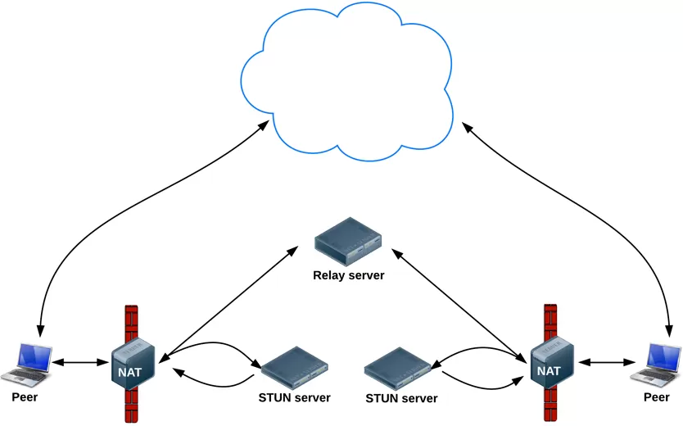
NAT Traversal

Slide 34
NAT Traversal
If UDP fails, ICE tries TCP: first HTTP, then HTTPS.
If direct connection fails—in particular, because of enterprise NAT traversal and firewalls—ICE uses an intermediary (relay) TURN server.
In other words, ICE will first use STUN with UDP to directly connect peers and, if that fails, will fall back to a TURN relay server.
The expression 'finding candidates' refers to the process of finding network interfaces and ports.

Slide 35
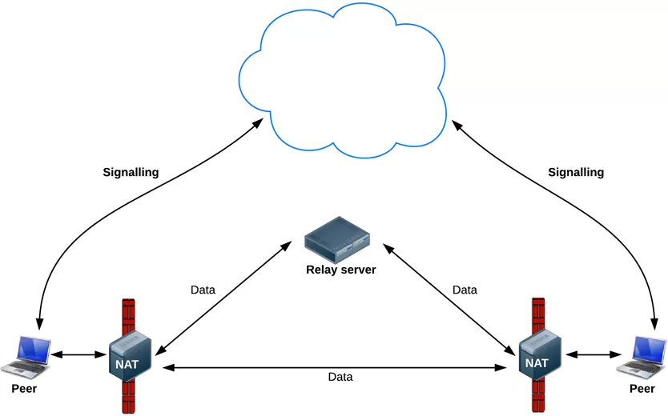
NAT Traversal

Slide 36
RTCDataChannel
As well as audio and video, WebRTC supports real-time communication for other types of data.
The RTCDataChannel API will enable peer-to-peer exchange of arbitrary data, with low latency and high throughput.
The API has several features to make the most of RTCPeerConnection and enable powerful and flexible peer-to-peer communication.

Slide 37
RTCDataChannel
Stream Control Transmission Protocol (SCTP) encapsulated in DTLS is used to handle DataChannel Data.
DataChannel API is bidirectional, which means that each DataChannel bundles an incoming and an outgoing SCTP stream.
Encapsulating "SCTP over DTLS over ICE over UDP" provides a NAT traversal solution together with confidentiality, source authentication, and integrity-protected transfers.

Slide 38
Security
There are several ways a real-time communication application or plugin might compromise security. For example:
Unencrypted media or data might be intercepted en route between browsers, or between a browser and a server.
An application might record and distribute video or audio without the user knowing.
Malware or viruses might be installed alongside an apparently innocuous plugin or application.

Slide 39
Security
WebRTC has several features to avoid these problems:
WebRTC implementations use secure protocols such as DTLS and SRTP.
Encryption is mandatory for all WebRTC components, including signaling mechanisms.
WebRTC is not a plugin: its components run in the browser sandbox and not in a separate process, components do not require separate installation, and are updated whenever the browser is updated.
Camera and microphone access must be granted explicitly and, when the camera or microphone are running, this is clearly shown by the user interface.

Slide 40
Current Limitations
Cloud Infrastructure – A server is required by WebRTC to complete four tasks: User discovery, Signalling and NAT/firewall traversal.
Native Applications – WebRTC enables real-time communication between web browsers. It is not a software development kit that can be used in native iOS or Android applications or in native desktop applications.
Multiparty Conferencing – WebRTC is peer-to-peer by nature which allows WebRTC to be extremely scalable, but it is very inefficient when setting up communications between more than two end users.
Recording – WebRTC does not support recording as of now.

Slide 41
Conclusion
The APIs and standards of WebRTC can democratize and decentralize tools for content creation and communication — for telephony, gaming, video production, music making, news gathering and many other applications.
WebRTC will have great impact on open web and interoperable browser technologies including the existing enterprise solutions.

Slide 42
What is WebRTC?
Web Browsers with Real-Time-Communication
● Audio/Video Chat on the web.
● Accessed through Javascript API.
● Does not require plugins, downloads or installs.
● Multiple browsers, multiple platforms.

Slide 43
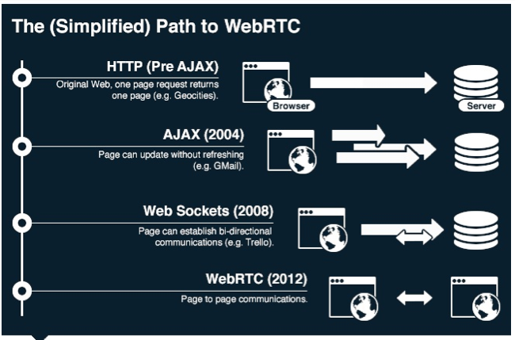
How did we get here?

Slide 44
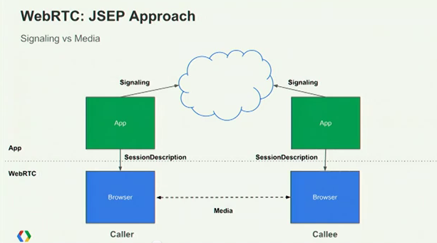
Javascript Session Establishment Protocol
Peer-to-peer exchange of data

Slide 45
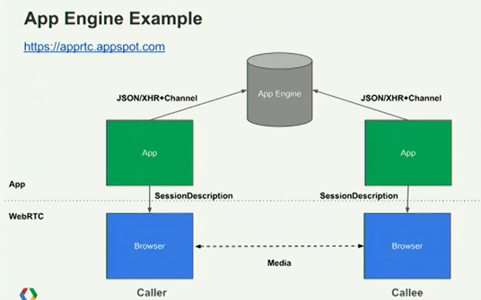
We can use webRTC.io!

Slide 46
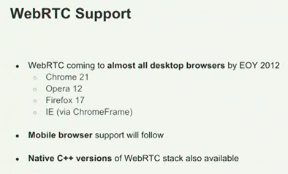
Who can use WebRTC? How?
http://www.webrtc.org/running-the-demos

Slide 47
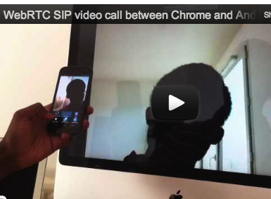
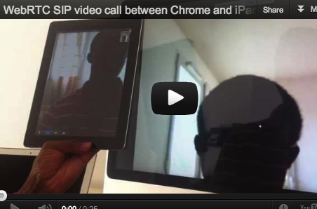
But wait... If WebRTC isn't on mobile, yet, what is this guy doing?
It is an open source HTML5 Sip Client.
http://www.sipml5.org/index.html

Slide 48
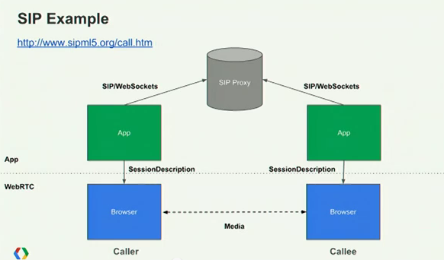
Instead of using webRTC.io, they used Javascript to implement the SIP Protocol.

Slide 49
But we just want to implement audio/video chat in a browser!
Let's use webRTC.io!
It's an abstraction layer for webRTC.
webRTC.io is to WebRTC as
socket.io is to WebSockets

Slide 50
Let's use webRTC.io to access WebRTC!
How does it work?
● MediaStreams – access to user's camera and mic
● PeerConnection – audio/video calls
● DataChannels – p2p application data transfer

Slide 51
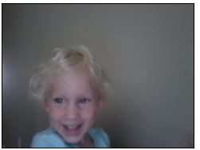
MediaStreams
PeerConnection
DataChannels
Let's make a WebRTC mirror!
<script src='webrtc.io.js'></script>
<!-- from https://github.com/webRTC/webrtc.io-client -->

Slide 52
MediaStreams
PeerConnection
DataChannels
Add a Video Tag.
<video id="me" autoplay></video>
Flip Video to show mirror image.
#me { -webkit-transform: rotateY(180deg); }

Slide 53
MediaStreams
PeerConnection
DataChannels
Display my video stream.
var PeerConnection = window.PeerConnection ||
window.webkitPeerConnection00;
if (PeerConnection) {
rtc.createStream({"video": true, "audio": true},
function(stream) {
rtc.attachStream(stream, 'me'); // <video id="me">
});
} else {
alert("Please use a WebRTC-enabled browser.");
}

Slide 54
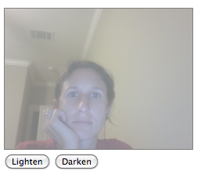
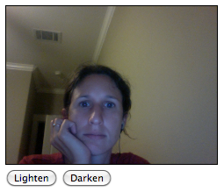
MediaStreams
PeerConnection
DataChannels
Let's lighten and darken the mirror,
in real time!
<script src='webrtc.io.js'></script>

Slide 55
MediaStreams
PeerConnection
DataChannels
Add buttons.
<button id='lighten'>Lighten</button>
<button id='darken'>Darken</button>
Lighten and darken the mirror.
$('#lighten').bind('click',function() {
if (videoOpacity > 0) {videoOpacity = videoOpacity - 0.1;}
$('#me').css('opacity',videoOpacity); // <video id="me">
});
$('#darken').bind('click',function() {
if (videoOpacity < 1) { videoOpacity = videoOpacity + 0.1;}
$('#me').css('opacity',videoOpacity);
});

Slide 56
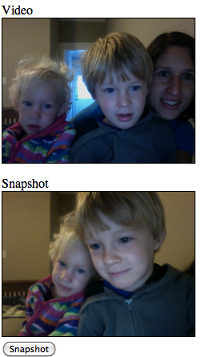
MediaStreams
PeerConnection
DataChannels
Let's make a WebRTC Photo Booth!
<script src='webrtc.io.js'></script>

Slide 57
MediaStreams
PeerConnection
DataChannels
Add video and canvas tags, and a snapshot button.
<video id="me" autoplay></video>
<canvas id=”snapshot”></canvas>
<button id=”snapPicture”>Snapshot</button>
Create Video and Canvas Objects.
var myVideo = document.getElementById("me");
var snapshotCanvas = document.getElementById("snapshot");

Slide 58
MediaStreams
PeerConnection
DataChannels
Take a frame of the video. Add it to the canvas.
$('#snapPicture').bind('click', function() {
snapshotCanvas // to <canvas id='snapshot'>
.getContext('2d')
.drawImage(myVideo, 0, 0, // from <video id="me">
snapshotCanvas.width,
snapshotCanvas.height);
});

Slide 59
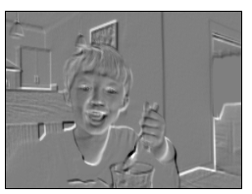
MediaStreams
PeerConnection
DataChannels
Let's make an Embossed WebRTC Mirror!
<script src='webrtc.io.js'></script>
<script src='seriously.js'></script>
<!-- from https://github.com/brianchirls/Seriously.js/ -->

Slide 60
MediaStreams
PeerConnection
DataChannels
Add video and canvas tags.
<video id="me" autoplay></video>
<canvas id=”snapshot”></canvas>
Take video frame. Add emboss affect.
Draw it on canvas.
seriously = new Seriously();
myVideo = seriously.source(“#me”); // source video
target = seriously.target('#snapshot'); // target canvas
emboss = seriously.effect('emboss');
emboss.source = myVideo; // emboss video frame
target.source = emboss; // draw to canvas
seriously.go();

Slide 61
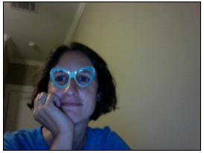
MediaStreams
PeerConnection
DataChannels
Let's Add Goofy WebRTC Glasses!
<script src='webrtc.io.js'></script>
<script src='ccv.js'></script>
<script src='face.js'></script>
<!-- from https://github.com/liuliu/ccv -->

Slide 62
MediaStreams
PeerConnection
DataChannels
Add video and canvas tags.
<video id="me" autoplay></video>
<canvas id=”snapshot”></canvas>
Load glasses image.
var glassses = new Image();
glasses.src = 'glasses2.png';
Keep detecting and drawing glasses.
playing = setInterval(function() {
showGlasses();
}, 200);

Slide 63
MediaStreams
PeerConnection
DataChannels
Draw video frame on canvas.
snapshotCanvas.getContext('2d')
.drawImage(myVideo,0,0,
snapshotCanvas.width, snapshotCanvas.height);
.

Slide 64
MediaStreams
PeerConnection
DataChannels
Detect face(s).
comp = ccv.detect_objects({
canvas: snapshotCanvas,
cascade: cascade,
interval: 4,
min_neighbors: 1
});
for (i = comp.length; i--; ) {
snapshotCanvas.getContext('2d')
.drawImage(glasses, comp[i].x, comp[i].y,
comp[i].width, comp[i].height);
}
Draw glasses on canvas.
.

Slide 65
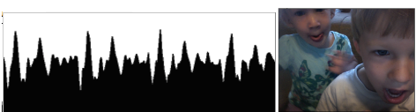
MediaStreams
PeerConnection
DataChannels
Let's see the audio in real time!
<script src='webrtc.io.js'></script>
<!-- Chrome 23. Enable Web Audio Input. -->

Slide 66
MediaStreams
PeerConnection
DataChannels
Add video and canvas tags.
<video id="me" autoplay></video>
<canvas id=”results”></canvas>
Define Buffer and Create Canvas Objects.
var buflen = 1024;
var buf = new Uint8Array( buflen );
var canvas = document.getElementById('results');
var ctx = canvas.getContext('2d');

Slide 67
MediaStreams
PeerConnection
DataChannels
Attach the stream.
rtc.attachStream(stream, 'me'); // from video
audioContext = new webkitAudioContext();
mediaStreamSource =
audioContext.createMediaStreamSource( stream );
analyser = audioContext.createAnalyser();
analyser.fftSize = 2048;
mediaStreamSource.connect( analyser );
// output audio through analyzer
Create an audio node from the stream.
Connect it to another node for processing.

Slide 68
MediaStreams
PeerConnection
DataChannels
Process buffer.
analyser.getByteTimeDomainData( buf );
// or analyser.getByteFrequencyData( buf );
ctx.clearRect(0, 0, canvas.width, canvas.height);
for (i=0;i<buf.length;i++) {
ctx.beginPath();
ctx.moveTo(i/2,200);
ctx.lineTo(i/2,200-buf[i]);
ctx.stroke();
}
Draw buffer data on canvas.

Slide 69
MediaStreams
PeerConnection
DataChannels
Keep updating sound.
function updateSound() {
// Add code to process buffer and draw to canvas.
rafID =
window.webkitRequestAnimationFrame( updateSound );
}

Slide 70
MediaStreams
PeerConnection
DataChannels
WebRTC Speech Recognition
Having fun?
By Jos Dirkson
1. Stream live audio with WebRTC
2. Record small WAV files with RecorderJS
3. Send WAV files to server with websockets
4. Convert WAV to FLAC with JavaFlacEncoder
5. Send audio in FLAC format to Undocumented Google API
6. Receive JSON string
“having fun”

Slide 71
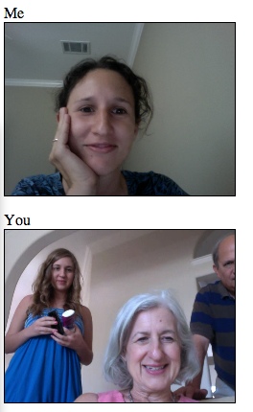
MediaStreams
PeerConnection
DataChannels
Let's make a Video Call!
<script src='webrtc.io.js'></script>
generative.edb.utexas.edu/webrtc-demos/videocall.html

Slide 72
MediaStreams
PeerConnection
DataChannels
My Client
http://generative
.edb.utexas.edu
/webrtc-demos
/videocall.html
webrtc.io.js
(client version)
requires
calls
Our Node.js Server
http://generative
.edb.utexas.edu
:60020
webrtc.io.js
(server version)
requires

Slide 73
MediaStreams
PeerConnection
DataChannels
Add our video tags.
<video id="me" autoplay></video>
<video id="you" autoplay></video>
Display my video stream.
if (PeerConnection) {
rtc.createStream({"video": true, "audio": true},
function(stream) {
rtc.attachStream(stream, 'me');
});
} else {
alert("Please use a WebRTC-enabled browser.");
}

Slide 74
MediaStreams
PeerConnection
DataChannels
Add a New Room button.
<button id='newRoom'>Create a New Room</button>
Create a new room.
$('#newRoom').bind('click', function() {
var randomString = createRandomString(); // = 'foo'
window.location.hash = randomString;
location.reload();
});
// From generative.edb.utexas.edu/webrtc-demos/videocall.html
// to generative.edb.utexas.edu/webrt-demos/videocall.html#foo

Slide 75
MediaStreams
PeerConnection
DataChannels
Find which room I'm in.
var room = window.location.hash.slice(1); // 'foo'
Connect to that room.
rtc.connect("ws://generative.edb.utexas.edu:60020",room);
Listen for a peer.
rtc.on('add remote stream', function(stream,socketId) {
console.log('peer ' + socketID + ' joined');
rtc.attachStream(stream,"you"); // <video id="you">
});
rtc.on('disconnect stream', function(data) {
console.log('peer ' + data + ' disconnected');
});

Slide 76
MediaStreams
PeerConnection
DataChannels
Run my Node.js server.
var app = require('express').createServer();
app.listen(60020); // port 60020, just because
var webRTC = require('webrtc.io').listen(app);
// from

Slide 77
MediaStreams
PeerConnection
DataChannels
Listen to events on the Node.js server.
webRTC.rtc.on('connect', function(rtc) {
console.log('user connected');
});
webRTC.rtc.on('send answer', function(rtc) {
console.log('answer sent');
});
webRTC.rtc.on('disconnect', function(rtc) {
console.log('user disconnected');
});

Slide 78
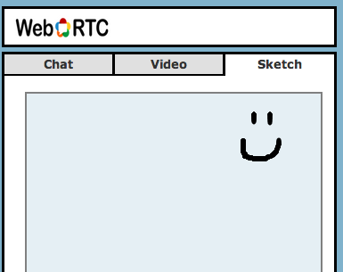
MediaStreams
PeerConnection
DataChannels
Send plain data with my Nurse Line App!
I used socket.io for Websockets.

Slide 79
MediaStreams
PeerConnection
DataChannels
DataChannels are coming soon!
Can replace websockets connection for sending data.
It will have:
● Peer-to-peer exchange of data
● Low latency
● High message rate/throughput
● Optional unreliable semantics

Slide 80
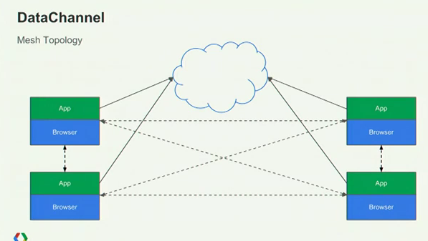
MediaStreams
PeerConnection
DataChannels
Mesh

Slide 81
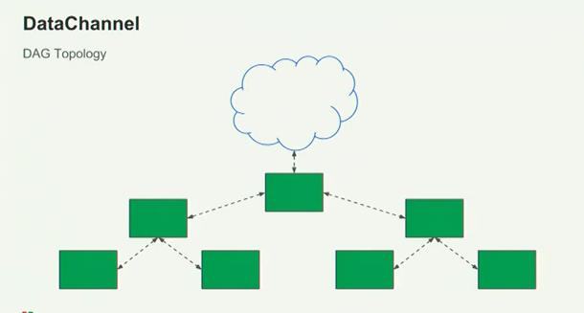
MediaStreams
PeerConnection
DataChannels
Tree

Slide 82
MediaStreams
PeerConnection
DataChannels
Comparing WebSockets and DataChannels!
WebSockets
Share events with server.
Broadcast to rooms.
Save client-specific data.
Send volatile messages.
Most current browsers.
Firewall issues.
Can run locally.
WebRTC
Share session info with server.
Share audio/video data with peer.
Broadcast to rooms.
Sure.
Send volatile messages.
Chrome, for now.
?
Can run locally.

Slide 83
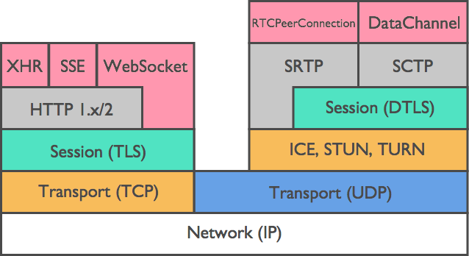
WebRTC Protocol Stack

Slide 84
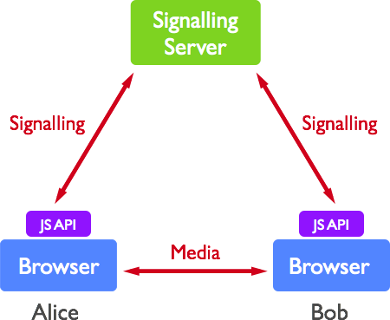

Slide 85
Signalling
Signaling is the process of coordinating communication. In order for a WebRTC application to set up a 'call', its clients need to exchange information:
Session control messages used to open or close communication.
Error messages.
Media metadata such as codecs and codec settings, bandwidth and media types.
Key data, used to establish secure connections.
Network data, such as a host's IP address and port as seen by the outside world.

Slide 86
Signalling
To connect to another user you should know where he is located on the Web.
The IP address of your device allows Internet-enabled devices to send data directly between each other.
TheRTCPeerConnection object is responsible for this.
As soon as devices know how to find each other over the Internet, they start exchanging data about which protocols and codecs each device supports.

Slide 87
Signalling
To communicate with another user you simply need to exchange contact information and the rest will be done by WebRTC.
Create a list of potential candidates for a peer connection.
The user or an application selects a user to make a connection with.
The signaling layer notifies another user that someone want to connect to him. He can accept or decline.
The first user is notified of the acceptance of the offer.
The first user initiates RTCPeerConnection with another user.
Both users exchange software and hardware information through the signaling server.
Both users exchange location information.
The connection succeeds or fails.

Slide 88
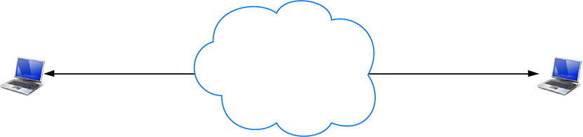
World without NAT

Slide 89
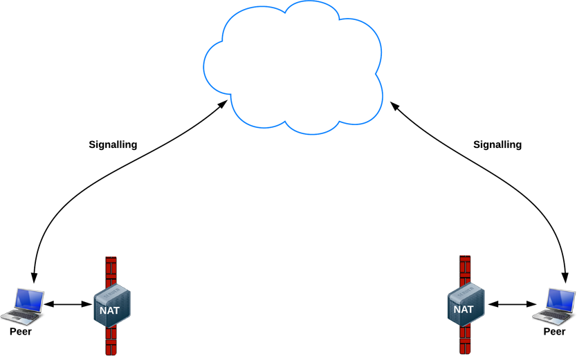
Real World

Slide 90
Using STUN servers to get public IP:port addresses
NATs provide a device with an IP address for use within a private local network, but this address can't be used externally.
Without a public address, there's no way for WebRTC peers to communicate.
To get around this problem WebRTC usesSTUN.
The application uses a STUN server to discover its IP:port from a public perspective.

Slide 91
Using STUN servers to get public IP:port addresses
This process enables a WebRTC peer to get a publicly accessible address for itself, and then pass that on to another peer via a signaling mechanism, in order to set up a direct link
Most WebRTC calls successfully make a connection using STUN: 86%, according to webrtcstats.com, though this can be less for calls between peers behind firewalls and complex NAT configurations.

Slide 92
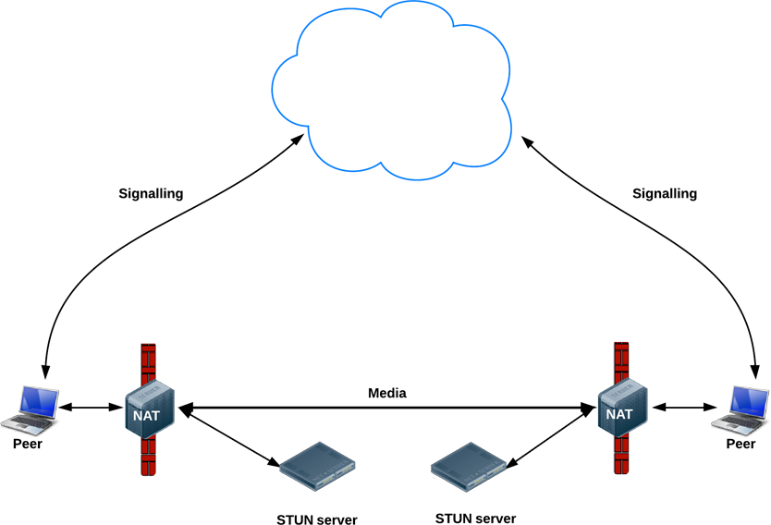
STUN: Session Traversal Utilities for NAT

Slide 93
TURN
RTCPeerConnection tries to set up direct communication between peers over UDP.
If that fails, RTCPeerConnection resorts to TCP.
If that fails, TURN servers can be used as a fallback, relaying data between endpoints.

Slide 94
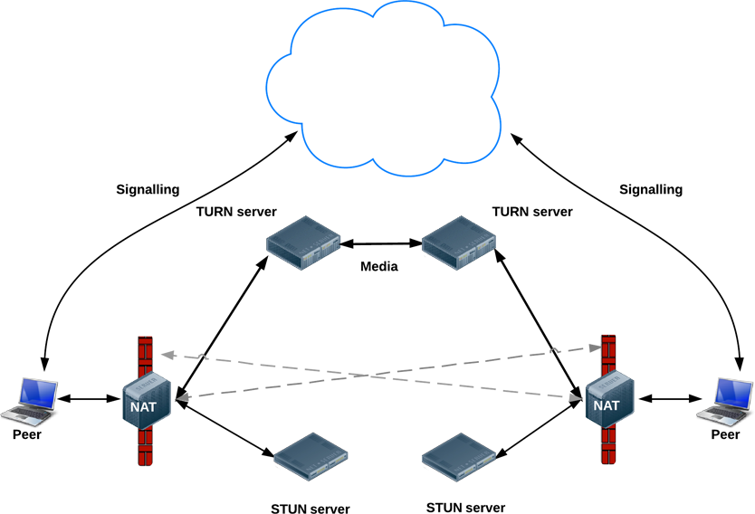
TURN
TURN: Traversal Using Relays around NAT

Slide 95
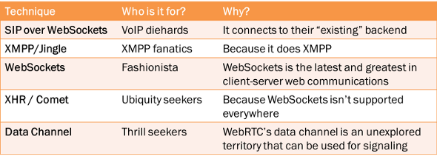
Signalling

Slide 96
Signalling Servers
webRTC.io: one of the first abstraction libraries for WebRTC.
easyRTC: a full-stack WebRTC package.
Signalmaster: a signaling server created for use with the SimpleWebRTCJavaScript client library.

Slide 97
SIP vs WebRTC
SIP is a protocol, not an API; whereas WebRTC is an API, with an associated set of protocols.
Consider that TCP is a protocol but socket is an API.
TCP has complex state machinery to enable reliable bi-directional end-to-end packet flow assuming that intermediate routers and networks can have problems but end to end reliability is assured.
On the other hand, the socket API hides all the complexity of TCP and provides an easy to use abstraction.
Luckily in the case of TCP, developers only work on top of the standardized socket API.
Whereas in the case of SIP, usually they end up dealing with the protocol directly, or work with (partly broken) implementations of intermediate network element such as a SIP proxy, or use (poorly defined) APIs from third-party SIP libraries.

Slide 98
SIP vs WebRTC
Depending on what level of abstraction is exposed in the SIP library, the development effort can range from very simple to very complex.
In the case of WebRTC, the API is being defined and standardized, and is intended as a high level abstraction suitable for JavaScript/Web developers. To list the differences between SIP and WebRTC - one could say that SIP is programming language agnostic but WebRTC is not, and must use JavaScript, or that SIP application could run on any device or platform, but a WebRTC application requires a browser to host the app.
These are superficial differences - due to the core difference in the nature of SIP vs. WebRTC, i.e., protocol vs. API.

Slide 99
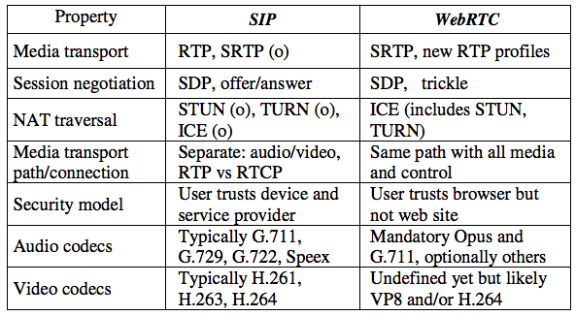

Slide 100
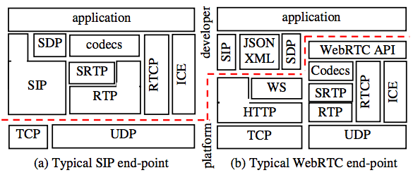

Slide 101
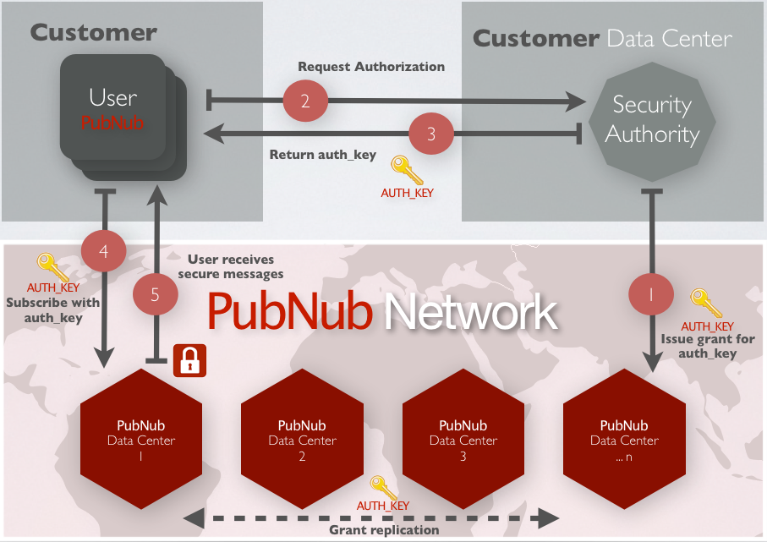
WebRTC Security with Access Control, AES & TLS/SSL encryption for Realtime Apps

Slide 102
Free Switch

Slide 103
Module type: Purpose:
Endpoint Telephone protocols like SIP/H.323 and POTS lines
Application Performs a task such as playing audio or setting data
Application
Programming
Interface (API)
Exports a function that takes text input and returns text output,
which could be used across modules or from an external
connection
Automated Speech
Recognition (ASR)
Interfaces with speech recognition systems
Chat Bridges and exchanges various chat protocols
Codec Translates between audio formats
Dialplan Parses the call details and decides where to route the call

Slide 104
Directory Connects directory information services, such as LDAP, to a
common core lookup API
Event handlers Allows external programs to control FreeSWITCH
File Provides an interface to extract and play sound from various
audio file formats
Formats Plays audio files in various formats
Languages Programming language interfaces used for call control
Loggers Controls logging to the console, system log, or log files
Say Strings together audio files in various languages to provide
feedback to say things like phone numbers, time of day, spell
words, and so on
Text-To-Speech (TTS) Interfaces with text-to-speech engines
Timers POSIX or Linux kernel timing in applications
XML Interfaces Uses XML for Call Detail Records (CDRs), RADIUS, CURL,
LDAP, RPC, and/or SCGI

